Slide 1


2017
WELCOME !
WUYI HENGHUI IMPORT & EXPORT CO.,LTD.
WUYI XINXIHANG INDUSTRY & TRADE CO.,LTD.
Add:NO.701-703,7th building,B block,Hushang Plaza,Wuyi,Zhejiang,China
E-mail: Williamwang324@VIP.163.COM
Tel:(0)13967979898 Website: www.crossmugs.com

Slide 2

WUYI XINXIHANG INDUSTRY & TRADE CO.,LTD.
Company ’s Brief Introdction
We are professional manufacturer of producing all kinds of travel mugs, vacuum flasks, sport bottles, lunch boxes ,food jugs etc.
Have got BSCI, SEDEX, WCA, GSV, ISO9001 Certification. Main market are Germany , UK , Poland ,USA and Australia. We have got good customers like as Tesco, Morrison, Wilkinson, BM, Poundland, Coop, Carrefour, Aldi, Lidl, Kaufland, CVS, Loblaw, Officework, Woolworth, Pepco, Sainsbury ,etc
All products meet food safety testing standard , we have got certificate like as LFGB,FDA,REACH,EN12546 etc. Now our daily production reach over 25,000pcs.

Slide 3

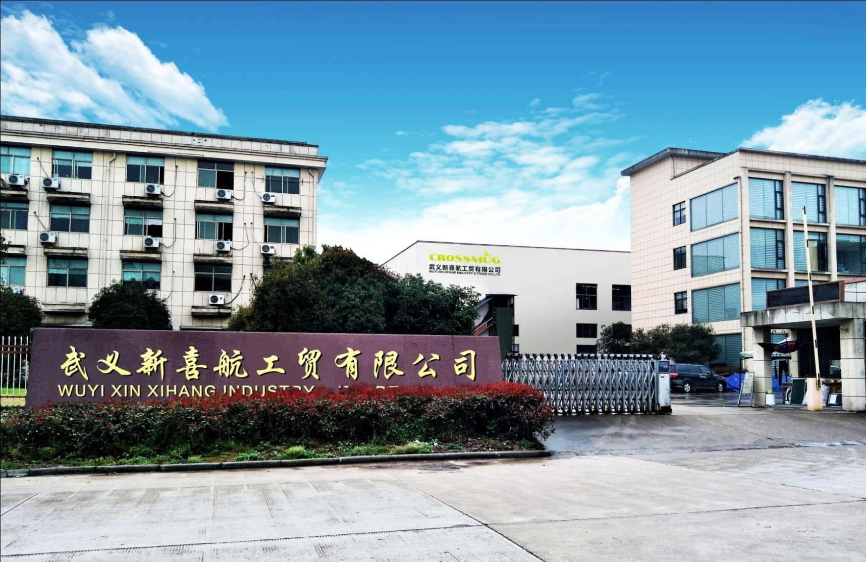
WUYI XIN XIHANG INDUSTRY & TRADE CO.,LTD.
ADD:No.108 Shenbao Road, Baiyang Industry Area, Wuyi, Zhejiang, China

Slide 4
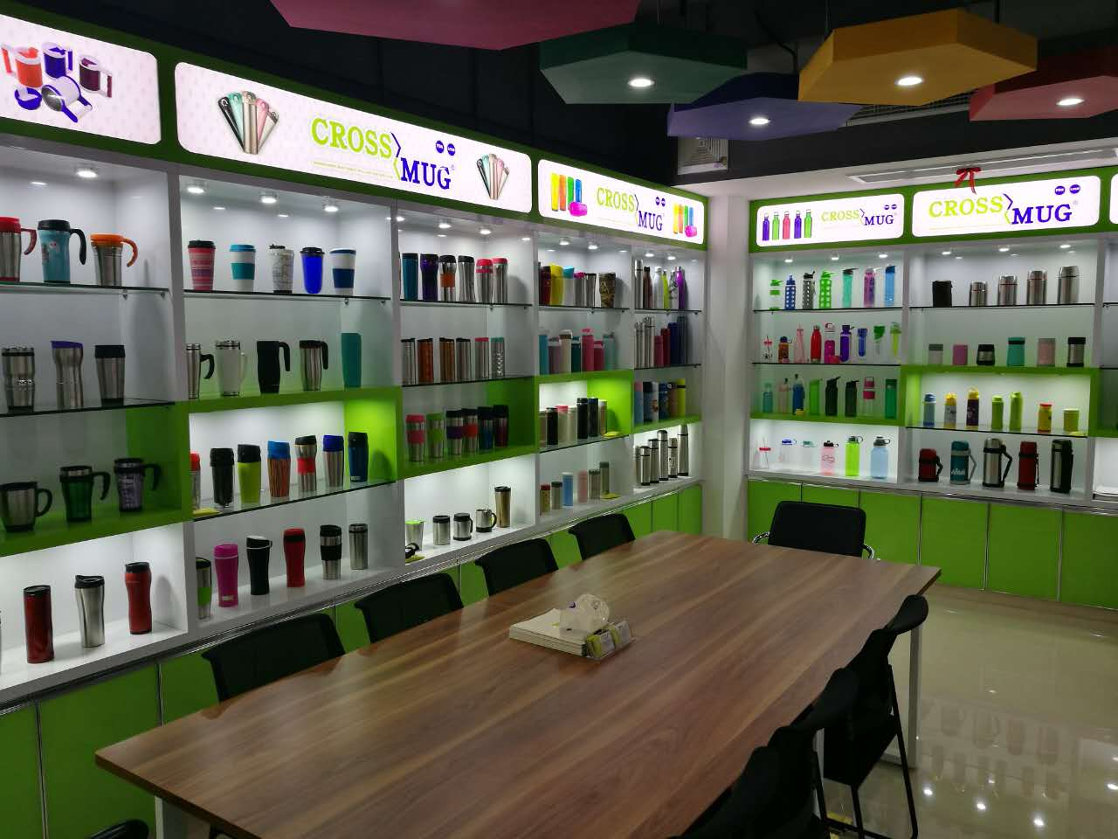
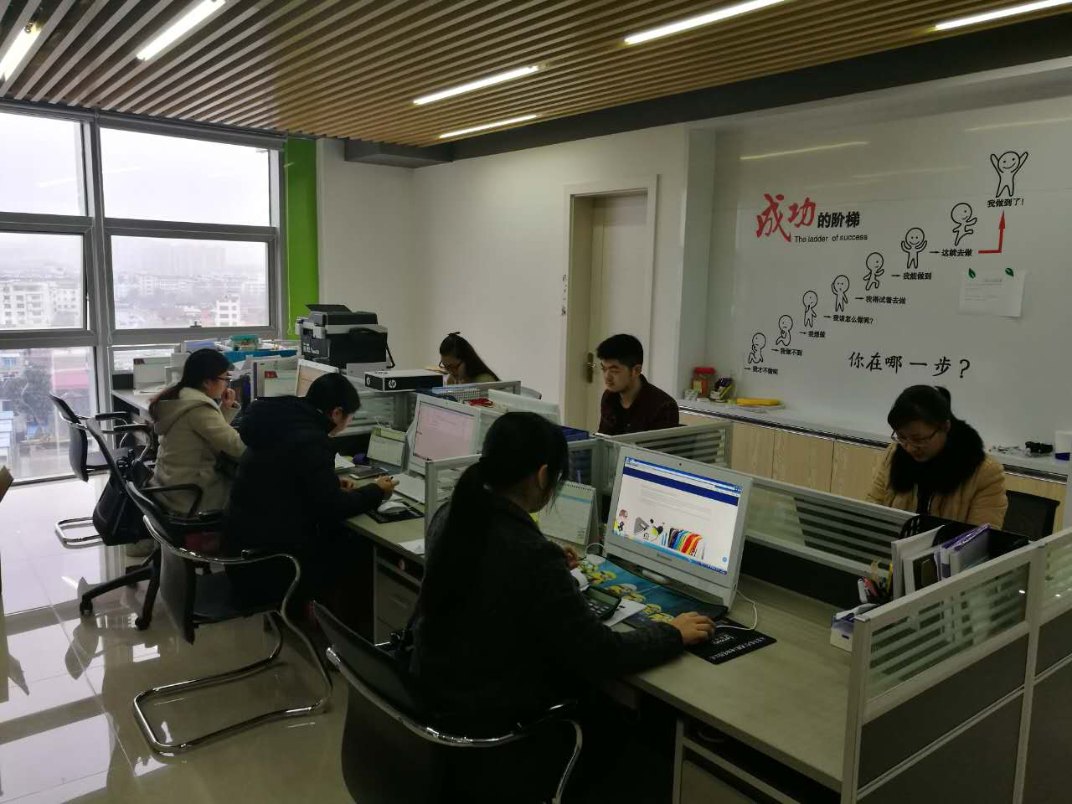

18 YEARS EXPERIENCE ON
DRINKING WARE
PROFESSIONAL SERVICE

Slide 5

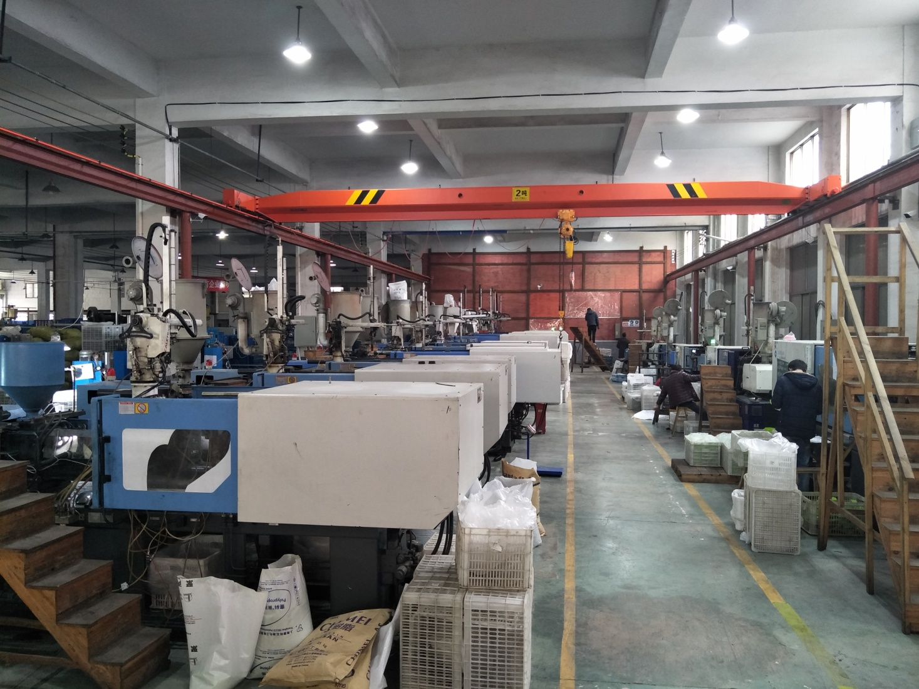
Injection Molding Workshop
18 injection machines. Daily production capacity is more than 50,000pcs

Slide 6

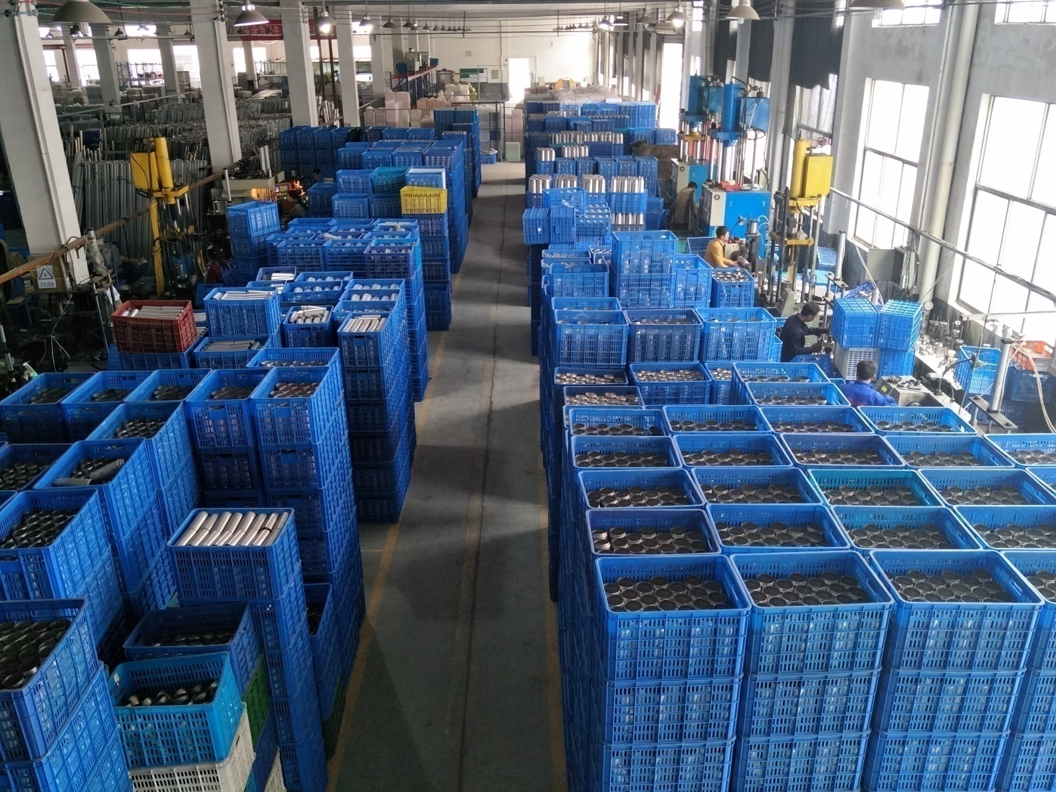
Metal Workshop
3 production line, Daily production capacity is more than 15,000pcs

Slide 7

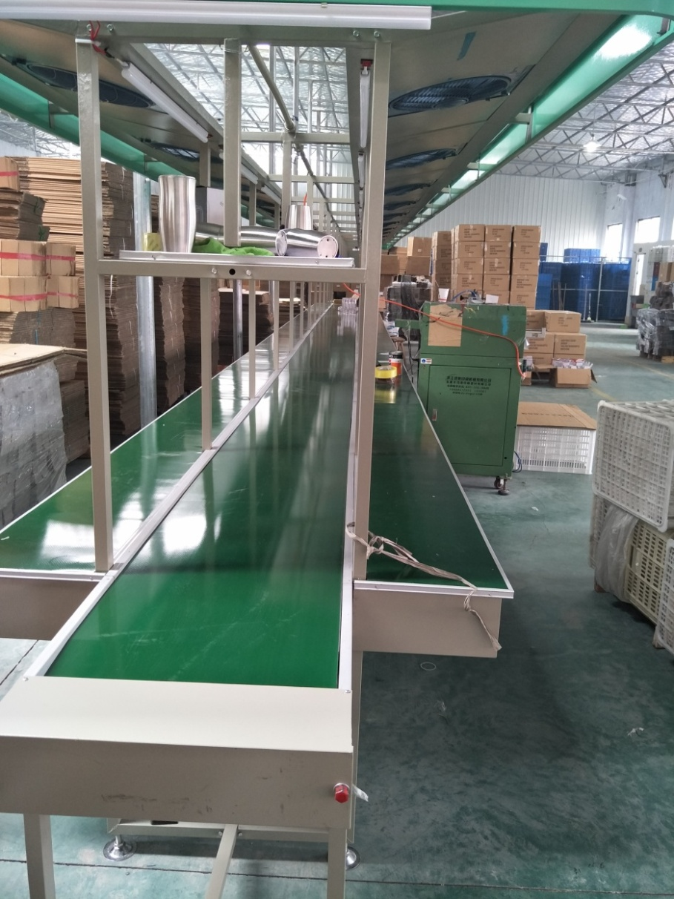
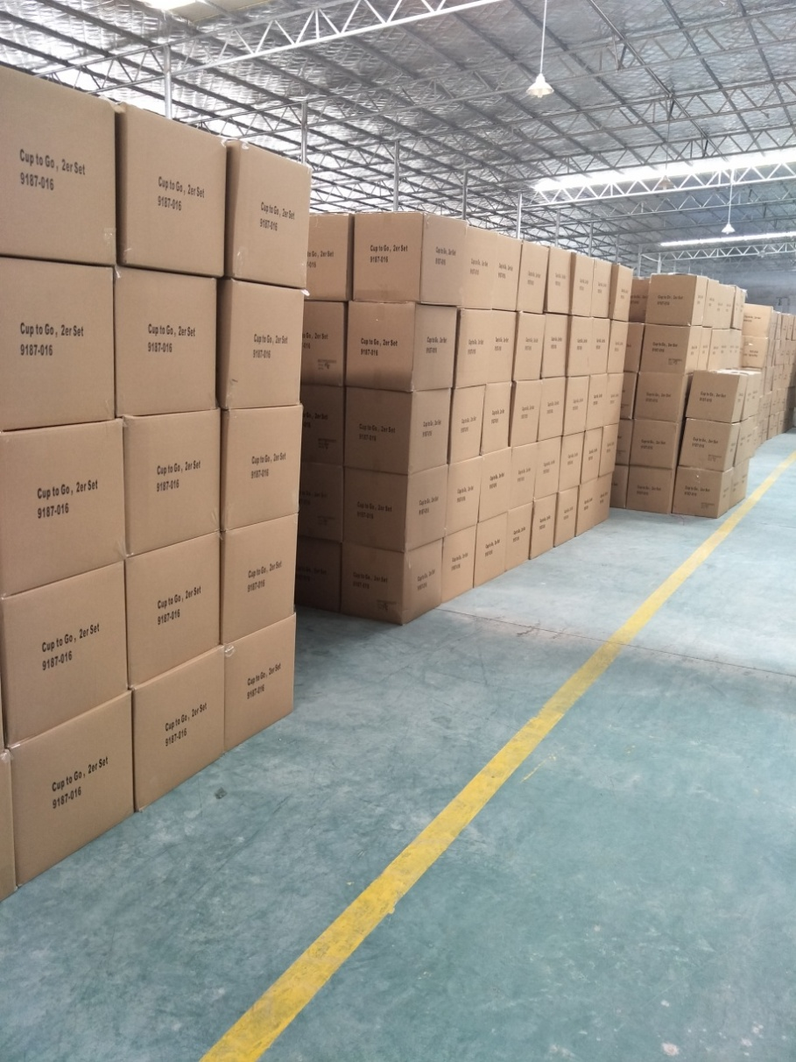
Assemble line & Warehouse

Slide 8




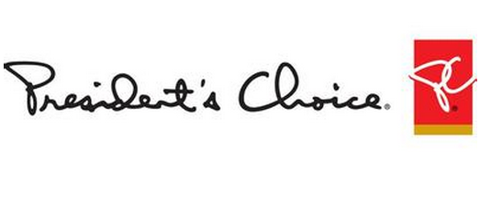

USA MARKET

Slide 9
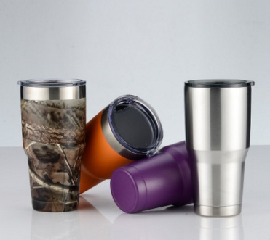
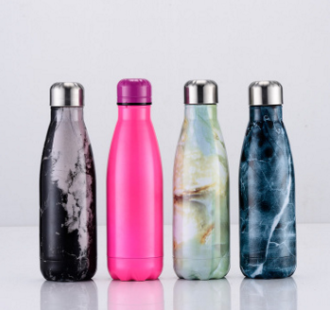
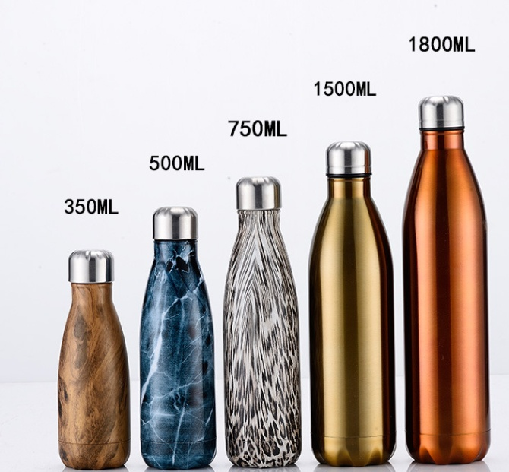
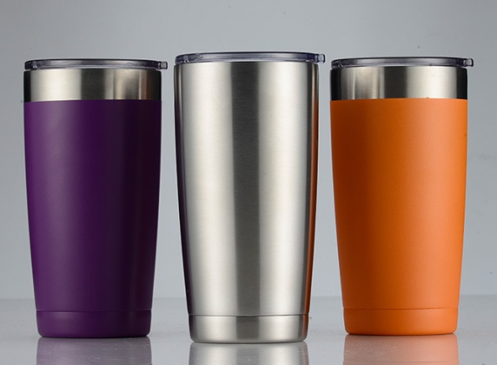
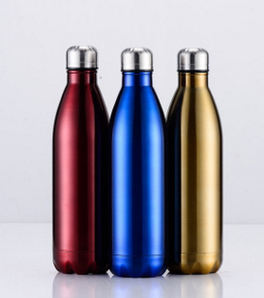
2016 USA MOST POPULAR ITEMS

Slide 10
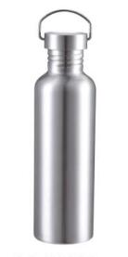
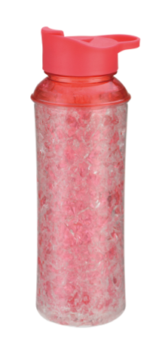
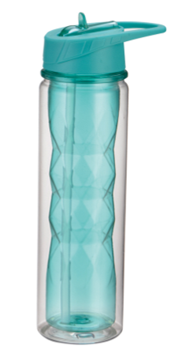
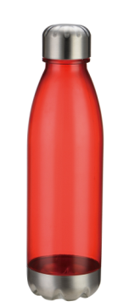
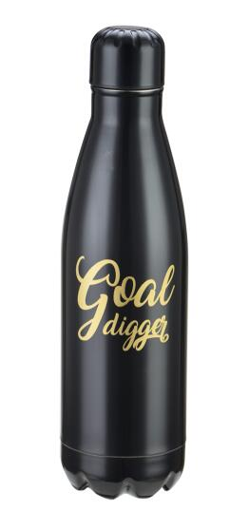
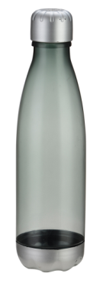
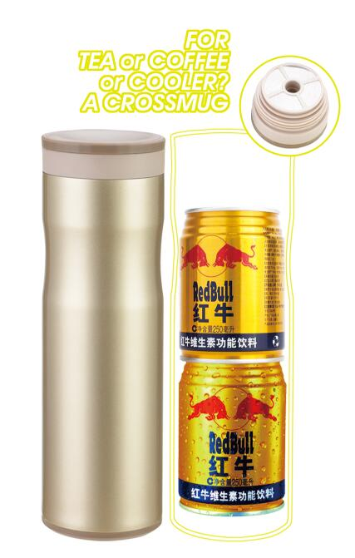
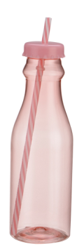
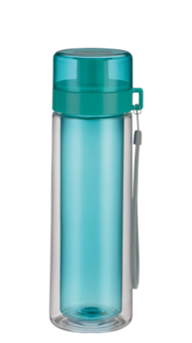
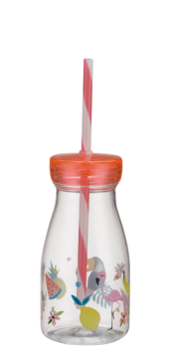
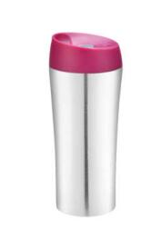
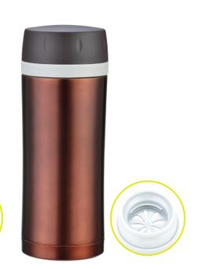
2017 POPULAR ITEM NEW EXTENSIONS

Slide 11














EUROPE & AUSTRALIA MARKET

Slide 12
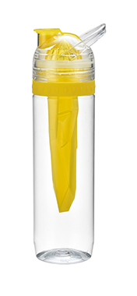
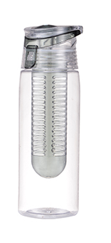
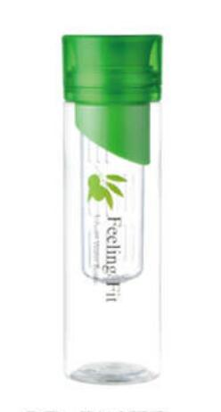
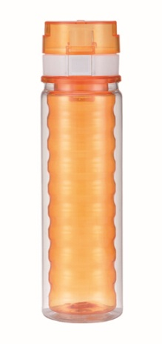
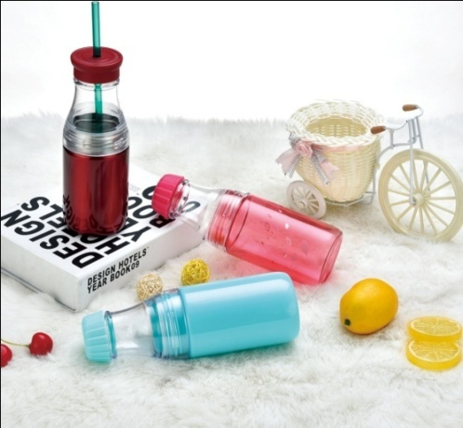
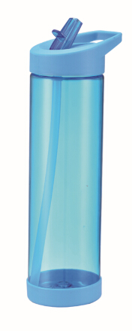
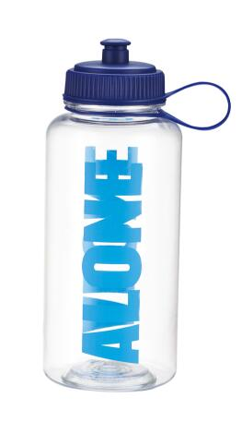
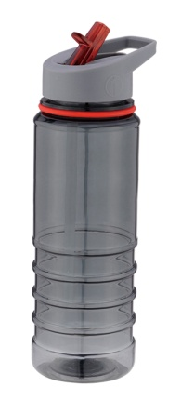
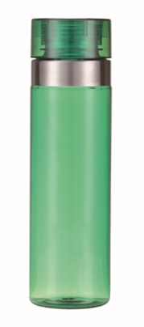
2016 EUROPE MARKET FASHIONS
TRITAN BOTTLE

Slide 13
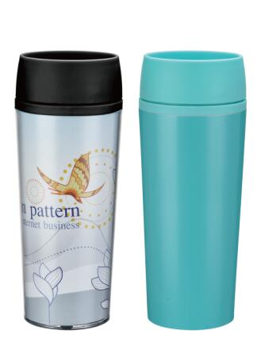
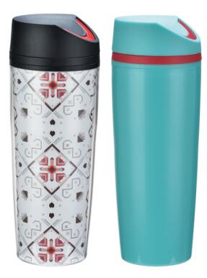
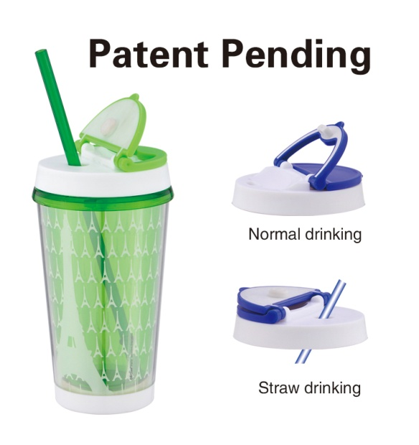
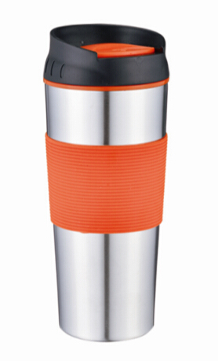
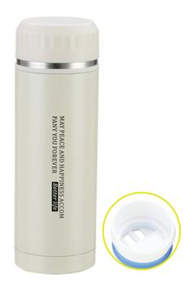
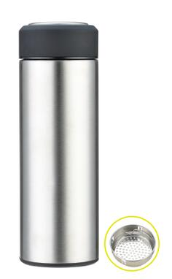
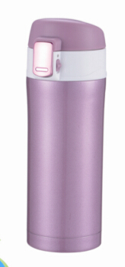

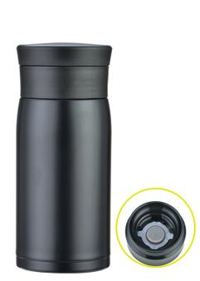
2017 CROSSMUG NEW EXTENSION
HEALTHY DRINKS
TEA MUG IS COMING

Slide 14
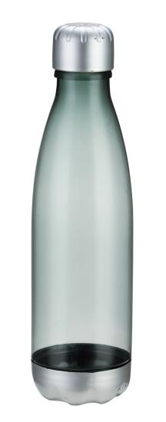
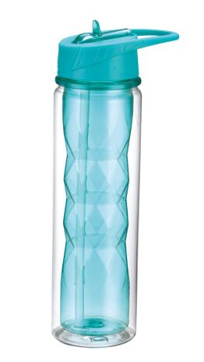
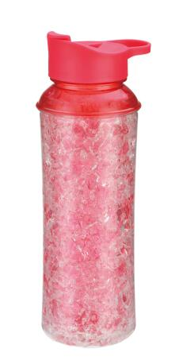
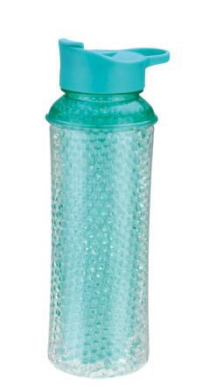
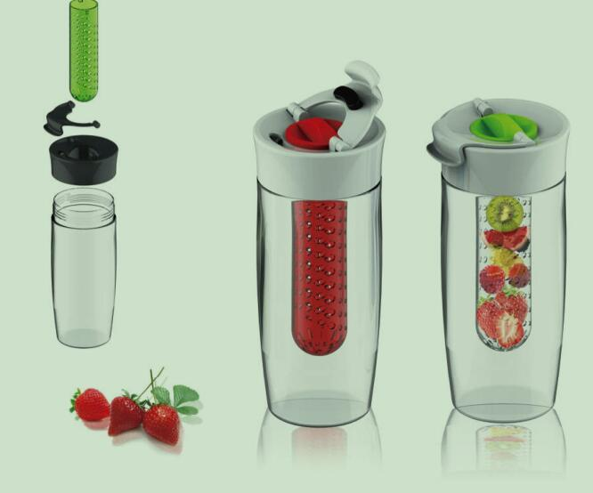
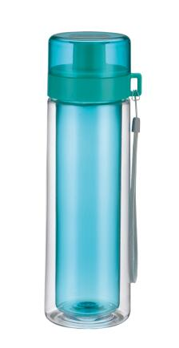
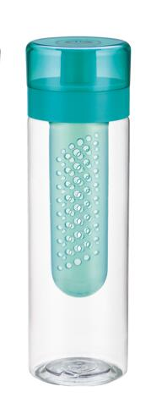
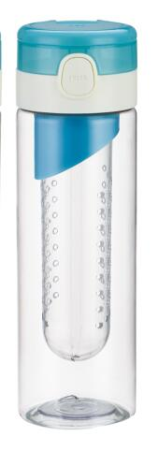
2017 FASHION BOTTLE NEW EXTENSION
Heathy life, Let’s join with fruittttt
FASHION LINE

