Slide 1
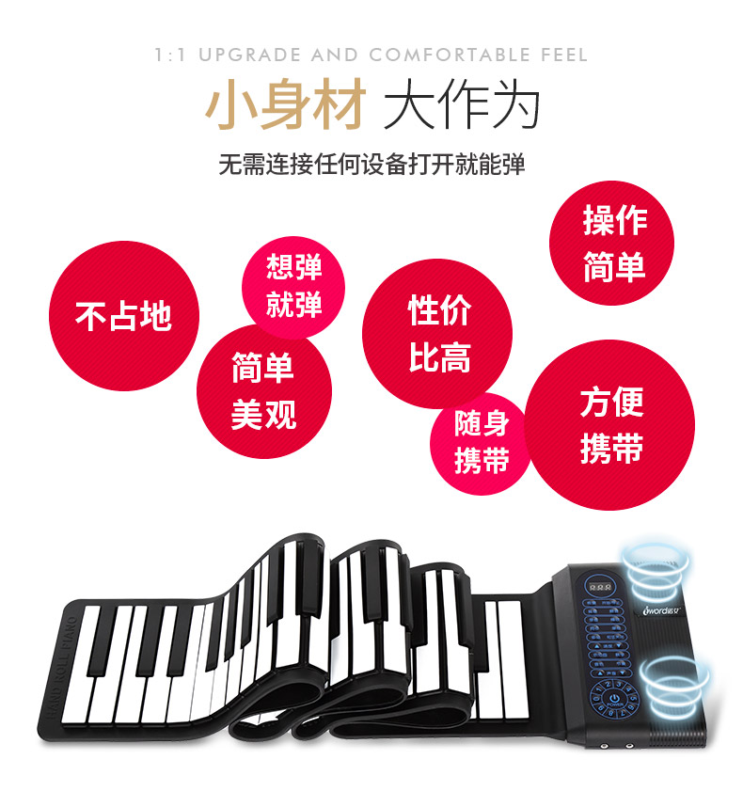
MAKE INSPIRING MUSIC ON THE GO
JOY ROLL PIANO
PRACTICE AND PLAY WHEREVER, WHENEVER
COMPACT SLIM DESIGN FOR ADDED PORTABILITY
DUAL STEREO SPEAKERS
QUALITY PIANO KEYS FOR ENHANCED STIMULATION
CONNECTS TO MULTIPLE DEVICE WITH USB CABLE
Iword

Slide 2
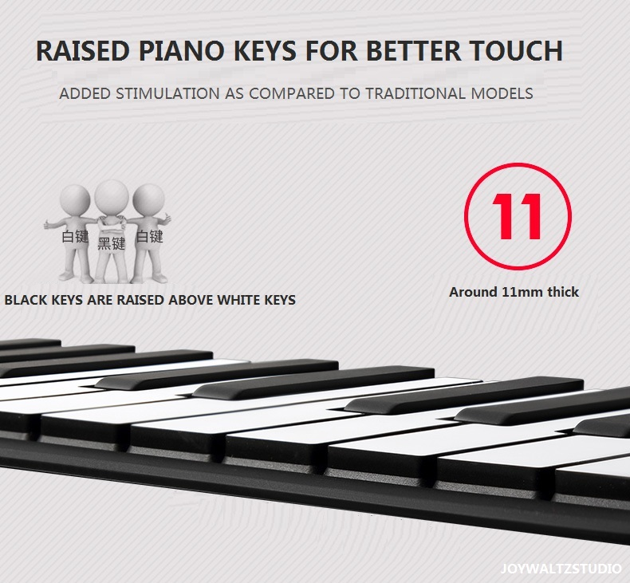

Slide 3
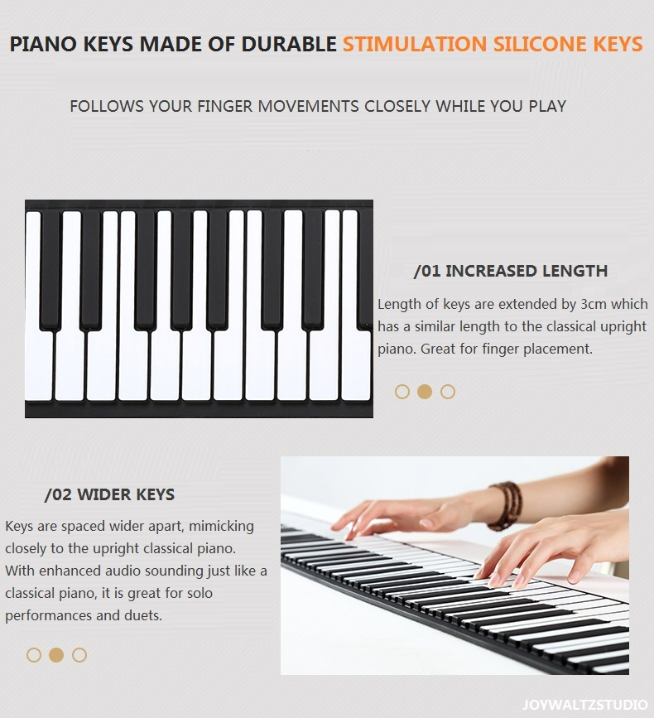

Slide 4
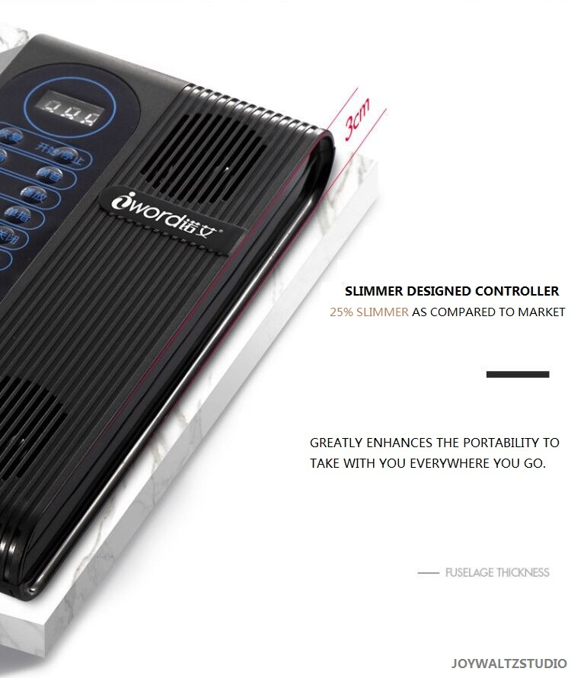

Slide 5
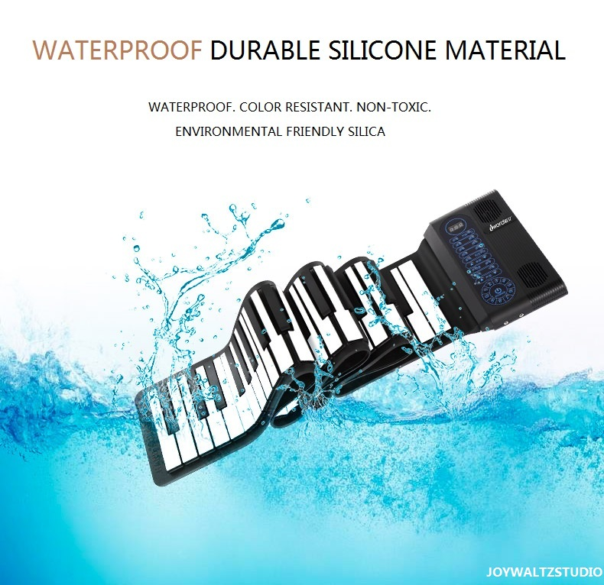

Slide 6
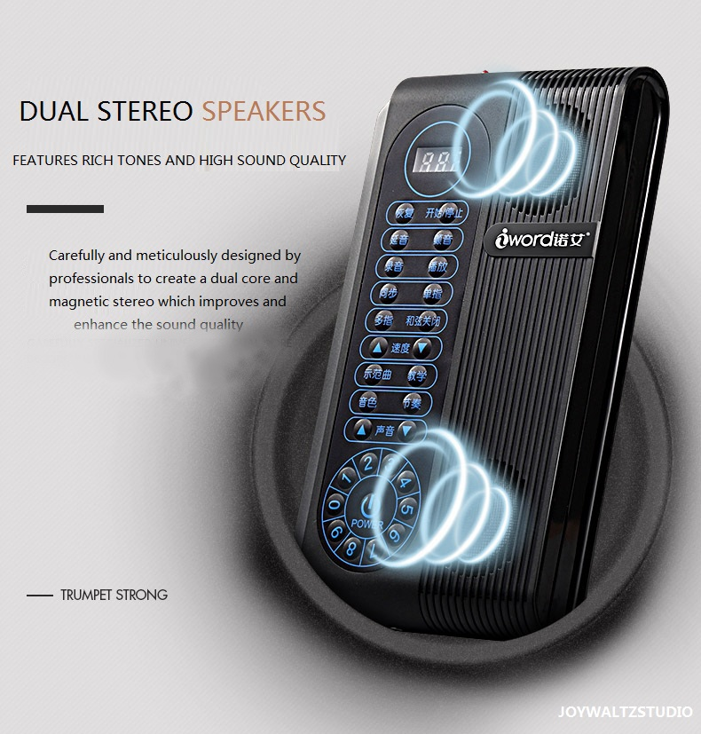
JOYWALTZSTUDIO

Slide 7
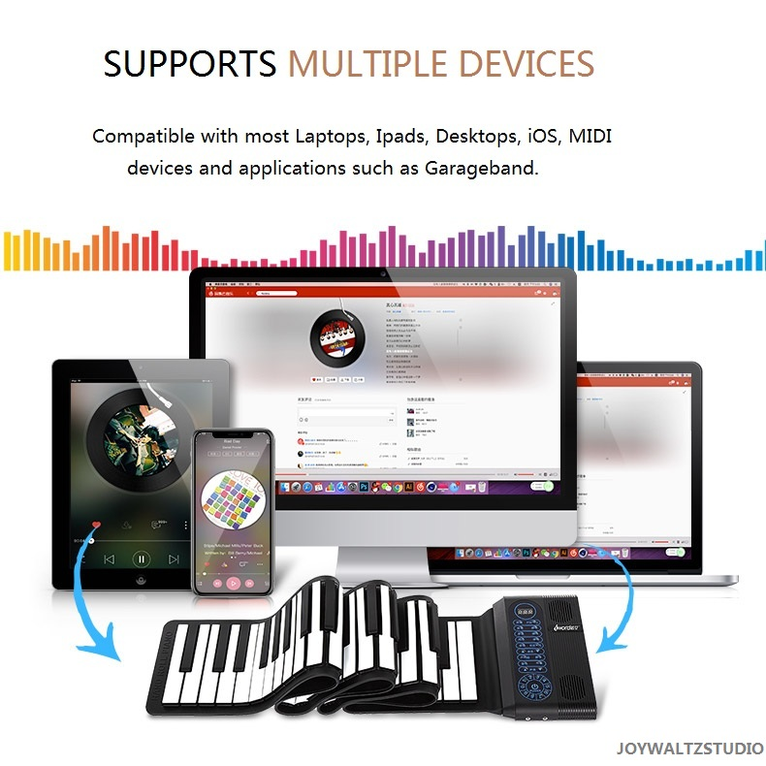
USB WIRE CHARGER
PORTABLE CHARGER

Slide 8
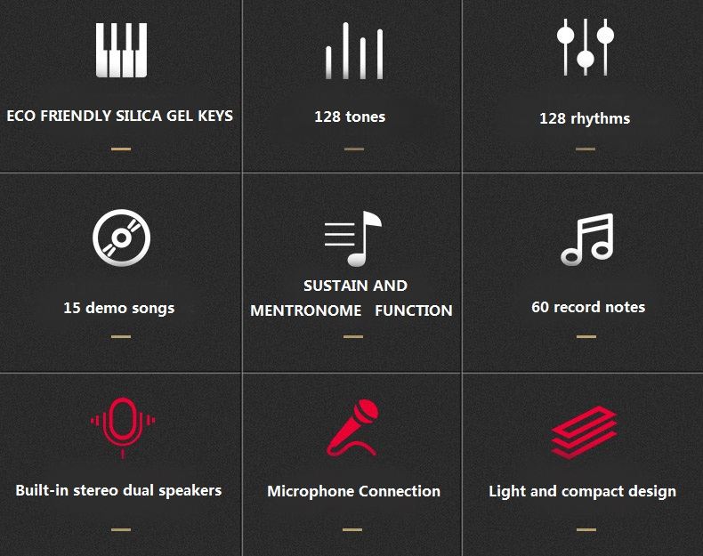

Slide 9
